Slide 1
Open Network Automation Platform (ONAP) Use Case Driven Architecture Proposal
DRAFT

Slide 2
Outline
Requirements from ONAP Use cases
Merger Architecture Proposal Overview
Merger Architecture Highlights

Slide 3
Contributors:
Vimal Begwani (AT&T)
Dean Bragg (AT&T)
Lingli Deng (CMCC)
Christopher Donley (Huawei)
Rajesh Gadiyar (Intel)
Xiaojun Xie (ChinaTelecom)
Alla Goldner (Amdocs)
Ranny Haiby (Nokia)
Jason Hunt (IBM)
Roberto Kung (Orange)
Xinhui Li (VMW)
Dhananjay Pavgi (TechMahindra)
Phil Robb (LF)
David Sauvageau (Bell Canada)
Stephen Terrill (Ericsson)
Huabing Zhao (ZTE)

Slide 4
Outline
Requirements from ONAP Use cases
Merger Architecture Proposal Overview
Merger Architecture Highlights

Slide 5


Use Case 1: vVoLTE
vSBC
vPCSCF
vI/SCSCF
vTAS
OS
OS
VXLAN
OS
OS
vSPGW
MPLS-TP / MPLS BGP L3VPN
OS
SPTN /
WAN
vPCRF
vHSS
vMME
GW
Edge DC
OS
VXLAN
OS
OS
GW
Core
DC
OSPF
VXLAN
EBGP-EVPN
Control Plane
Overlay
OSPF
Underlay

Slide 6
High Level Requirements:
Functional Requirements:
Onboard VoLTE VNFs, Design and Create vVoLTE Services (topology, workflow, policy, analysis)
Deploy Artifacts
Fault detection, correlation and policy based auto-healing
Performance Monitoring and policy based auto scaling
Standard ETSI-NFV interfaces integrate with vendor provided VNFM
Integrate with vendor provided EMS
Integrate with third party controller
Leverage capabilities of different infrastructure environment
Platform Requirements:
Support for Orchestration of complex deployment
ETSI NFV Interface With Vendor Provided VNFM / EMS
Interface with third party controller and multiple Cloud Infrastructures
Easy to Use Closed Loop Automation Design
Notes:
Requirements:
Onboard Various VNFs
Deploy Artifacts
Initial Deployment / Instantiation
Scaling up / down automatically
Fault detection and correlation
Auto-healing
Standard ETSI-NFV interfaces integrate with vendor provided VNFM
Integrate with vendor provided EMS
Integrate with third party controller
Challenges / Gaps:
Orchestration for complex deployment
Closed Loop Automation

Slide 7
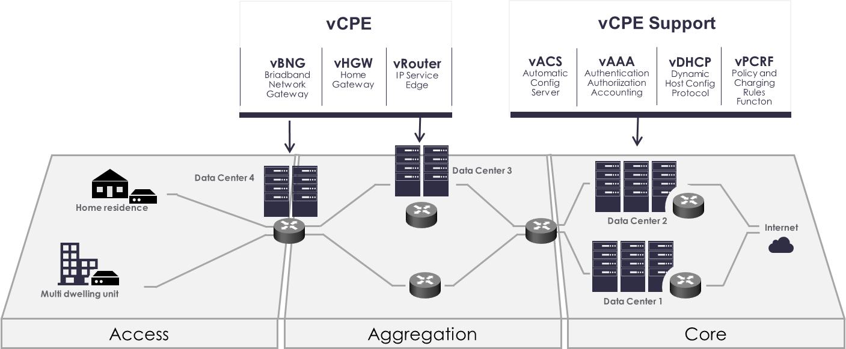
Use Case 2: vCPE

Slide 8
High Level Requirements:
Functional Requirements:
Onboarding, Creation and Design of Virtualized Residential Broadband Service
Customer ordering – Instantiation, Per service activation, Cut service
Self-service -- Tiered bandwidth, Bandwidth on Demand
Software management – Upgrade, Delete
Auto-healing -- Automatic reboot/restart, Rebuild
Fault detection and correlation between L2-L3 connectivity services and Internet, VoIP, Video applications
Manage localized broadband services by automatically performing the healthcheck of the access connectivity, virtual switching/routing and auditing of service-related configurations
Deliver high availability service requirements for emergency communications and surveillance services
Platform Requirements:
Easy to use Change Management Design & Execution
Easy to Use Closed Loop Automation Design
End2end fault/alert report, events and monitoring data collection from infrastructure to service
Notes:
Request clarification on topology driven orchestration. If not clear, suggest to remove.

Slide 9
Proposed Requirements to Support two Use Cases:
ONAP Use case Functional Requirements
Requirement 1: ONAP Controller Framework to Provide Easy to Add Adaptor(s) for vendor provided VNF Managers, when necessary (Use case 1 & 2)
Requirement 2: ONAP Controller Framework to Provide Easy to Add Adaptors for external controller (Use case 1 & 2)
Requirement 3: ONAP SDC to Implement Template Driven Closed Loop Automation (Use case 1 & 2)
Requirement 4: ONAP SDC to onboard TOSCA based VNFs (Use case 1 & 2)
Requirement 5: ONAP SDC to easily create LCM workflow for Service Template (Use case 1&2)
Requirement 6: ONAP to Provide a Framework for Designing, Scheduling and Executing Planned Changes, Including Software Upgrades (Use Case 2)
ONAP Platform Requirements:
Requirement 7: Provide Tools for Vendor Self-Service VNF Certification (VNF SDK)
Requirement 8: Simplify ONAP Platform Deployment and Management by Introducing ONAP Controller
Requirement 9: Resources & Placement Optimization
Requirement 10: Support for Multiple Infrastructure Environments
Notes:
Suggest to remove requirement 1: ONAP Orchestrator to include a declarative topologically-driven approach to orchestration, in addition to imperative BPMN/BPEL capabilities(Use case 1 & 2)

Slide 10
Outline
Requirements from ONAP Use cases
Merger Architecture Proposal Overview
Merger Architecture Highlights

Slide 11
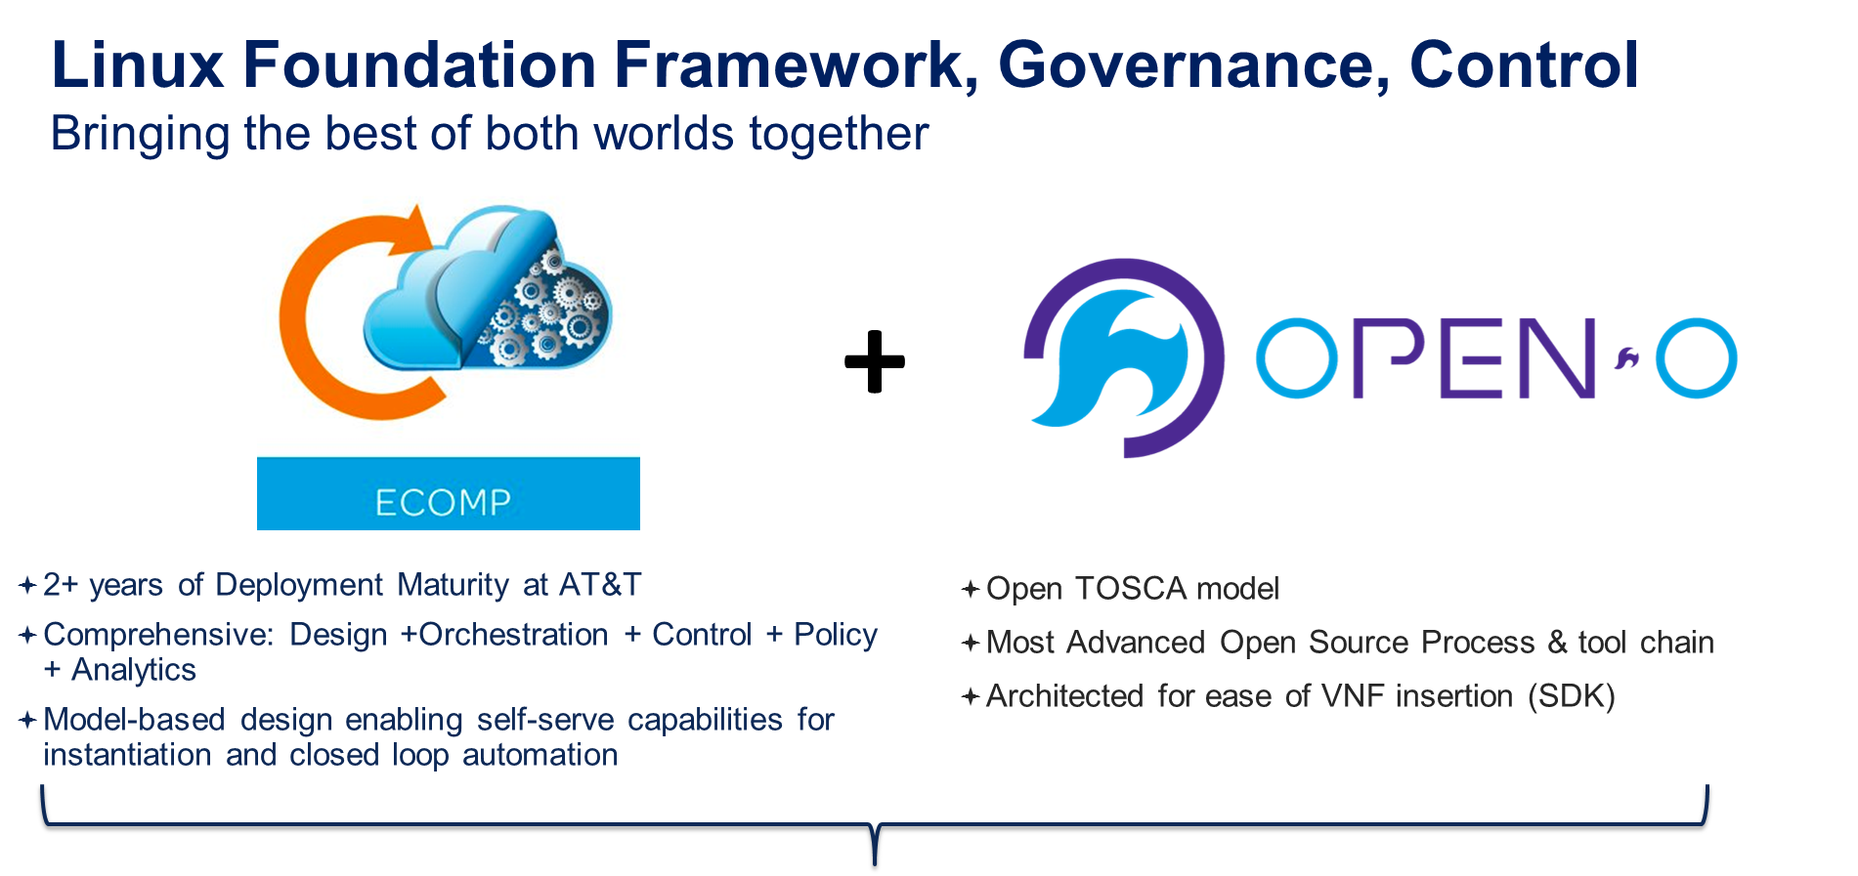

Slide 12

ONAP Merger Architecture Proposal
E-Services
BSS/OSS
Big Data
Portal
Run-time
OPEN-O UI
(GUI/CLI)
Dashboard OA&M
(VID)
External Data Movement & APIs
Modeling (specs & Utilities)
Integration
Certification & Lab
Design-time
A&AI
Service
Orchestrator
SDC
GS-O
UI Server
VNF Design
Service Design
Common Service
DMaaP
ESR
Auth.
Microservice Bus
Workflow Design
Policy Creation
DCAE
Policy
Controllers
Alarm Correlation App (Holmes)
SDN Agent
(SDN-O)
Infra-C
SDN-C
APP-C
VF-C
Analytic Application Creation
Recipie/
Engineering Rules & Policy Distribution
NFV-O
NFV-O NFV Collector
(Monitor)
GVNFM
Catalog
Mediation Layer
SDN Hub Driver
Multi-VIM
Multi VNFM/EMS Driver
VNF SDK
Cloud & WAN
OpenStack
VMware
RackSpace
Azure
......
Legend:
From
openECOMP
From
OPEN-O
Convergence from both sides
New
3rd

Slide 13
From ECOMP: Design & Run Time & Close Loop
E-Services
BSS/OSS
Big Data
Portal
Run-time
OPEN-O UI
(GUI/CLI)
Dashboard OA&M
(VID)
External Data Movement & APIs
Modeling (specs & Utilities)
Integration
Certification & Lab
Design-time
A&AI
Service
Orchestrator
SDC
GS-O
UI Server
VNF Design
Service Design
Common Service
DMaaP
ESR
Auth.
Microservice Bus
Workflow Design
Policy Creation
DCAE
Policy
Controllers
Alarm Correlation App (Holmes)
SDN Agent
(SDN-O)
Infra-C
SDN-C
APP-C
VF-C
Analytic Application Creation
Recipie/
Engineering Rules & Policy Distribution
NFV-O
NFV-O NFV Collector
(Monitor)
GVNFM
Catalog
Mediation Layer
SDN Hub Driver
Multi-VIM
Multi VNFM/EMS Driver
VNF SDK
Cloud & WAN
OpenStack
VMware
RackSpace
Azure
......
Legend:
From
openECOMP
From
OPEN-O
Convergence from both sides
New
3rd

Slide 14
From OPEN-O: open TOSCA model
E-Services
BSS/OSS
Big Data
Portal
Run-time
OPEN-O UI
(GUI/CLI)
Dashboard OA&M
(VID)
External Data Movement & APIs
Modeling (specs & Utilities)
Integration
Certification & Lab
Design-time
A&AI
Service
Orchestrator
SDC
GS-O
UI Server
VNF Design
Service Design
Common Service
DMaaP
ESR
Auth.
Microservice Bus
Workflow Design
Policy Creation
DCAE
Policy
Controllers
Alarm Correlation App (Holmes)
SDN Agent
(SDN-O)
Infra-C
SDN-C
APP-C
VF-C
Analytic Application Creation
Recipie/
Engineering Rules & Policy Distribution
NFV-O
NFV-O NFV Collector
(Monitor)
GVNFM
Catalog
Mediation Layer
SDN Hub Driver
Multi-VIM
Multi VNFM/EMS Driver
VNF SDK
Cloud & WAN
OpenStack
VMware
RackSpace
Azure
......
Legend:
From
openECOMP
From
OPEN-O
Convergence from both sides
New
3rd

Slide 15
From OPEN-O: open source process & tools
E-Services
BSS/OSS
Big Data
Portal
Run-time
OPEN-O UI
(GUI/CLI)
Dashboard OA&M
(VID)
External Data Movement & APIs
Modeling (specs & Utilities)
Integration
Certification & Lab
Design-time
A&AI
Service
Orchestrator
SDC
GS-O
UI Server
VNF Design
Service Design
Common Service
DMaaP
ESR
Auth.
Microservice Bus
Workflow Design
Policy Creation
DCAE
Policy
Controllers
Alarm Correlation App (Holmes)
SDN Agent
(SDN-O)
Infra-C
SDN-C
APP-C
VF-C
Analytic Application Creation
Recipie/
Engineering Rules & Policy Distribution
NFV-O
NFV-O NFV Collector
(Monitor)
GVNFM
Catalog
Mediation Layer
SDN Hub Driver
Multi-VIM
Multi VNFM/EMS Driver
VNF SDK
Cloud & WAN
OpenStack
VMware
RackSpace
Azure
......
Legend:
From
openECOMP
From
OPEN-O
Convergence from both sides
New
3rd

Slide 16
From OPEN-O: Ease of VNF Insertion
E-Services
BSS/OSS
Big Data
Portal
Run-time
OPEN-O UI
(GUI/CLI)
Dashboard OA&M
(VID)
External Data Movement & APIs
Modeling (specs & Utilities)
Integration
Certification & Lab
Design-time
A&AI
Service
Orchestrator
SDC
GS-O
UI Server
VNF Design
Service Design
Common Service
DMaaP
ESR
Auth.
Microservice Bus
Workflow Design
Policy Creation
DCAE
Policy
Controllers
Alarm Correlation App (Holmes)
SDN Agent
(SDN-O)
Infra-C
SDN-C
APP-C
VF-C
Analytic Application Creation
Recipie/
Engineering Rules & Policy Distribution
NFV-O
NFV-O NFV Collector
(Monitor)
GVNFM
Catalog
Mediation Layer
SDN Hub Driver
Multi-VIM
Multi VNFM/EMS Driver
VNF SDK
Cloud & WAN
OpenStack
VMware
RackSpace
Azure
......
Legend:
From
openECOMP
From
OPEN-O
Convergence from both sides
New
3rd

Slide 17
Looking forward: Multiple Vendors Environment
E-Services
BSS/OSS
Big Data
Portal
Run-time
OPEN-O UI
(GUI/CLI)
Dashboard OA&M
(VID)
External Data Movement & APIs
Modeling (specs & Utilities)
Integration
Certification & Lab
Design-time
A&AI
Service
Orchestrator
SDC
GS-O
UI Server
VNF Design
Service Design
Common Service
DMaaP
ESR
Auth.
Microservice Bus
Workflow Design
Policy Creation
DCAE
Policy
Controllers
Alarm Correlation App (Holmes)
SDN Agent
(SDN-O)
Infra-C
SDN-C
APP-C
VF-C
Analytic Application Creation
Recipie/
Engineering Rules & Policy Distribution
NFV-O
NFV-O NFV Collector
(Monitor)
GVNFM
Catalog
Mediation Layer
SDN Hub Driver
Multi-VIM
Multi VNFM/EMS Driver
VNF SDK
Cloud & WAN
OpenStack
VMware
RackSpace
Azure
......
Legend:
From
openECOMP
From
OPEN-O
Convergence from both sides
New
3rd

Slide 18
Outline
Requirements from ONAP Use cases
Merger Architecture Proposal Overview
Merger Architecture Highlights
ONAP Modeling
ONAP Common Service
ONAP Service Orchestrator
ONAP Controllers
Overview
VF-C
SDN-Agent
Template Driven Closed Loop
Support for Design, Schedule and Execute Changes (e.g. Software Upgrades)
VNF SDK
Resource and Placement Optimization
Operations Management Framework (OMF)
Support for Multiple Infrastructure Environments

Slide 19
ONAP Modeling Overview
Tosca/Yang/Hot template and data modeling for VNF and Service
A common informational model specification for different data modeling
Parser and translator code about NFV data modeling and tools
Policy model specify EMF and SUPA

Slide 20
Landscape of modeling in ONAP
Deployment
Model
Design
BPEL
TOSCA
DG
Runtime
SO
A&AI
SDC
HEAT
YANG
Policy
EMF
TOSCA
HEAT
DG
Network-C
L1-L3
Infra-C
APP-C
L4-L7
VNF-C
DCAE
DG
YANG
TOSCA
YANG
TOSCA
BPEL
NFVO
GVNFM
EMF
Policy
YANG
HEAT
YANG
EMF
RESTCONF
YANG
SVNFM
EMS
YANG
Policy
BPEL
FCAPS
Service Conf.
SDN
Controller
OPENSTACK
HEAT
ODL
DG
NEUTRON
HEAT
YANG
NETCONF
YANG
SWIFT
GLANCE
CINDER
TOSCA
YANG
Management
Model
VNF in DC
(lb, fw…)
VNF in Core
(EPC, IMS…)
Network Device

Slide 21
VNF Modelling
Vendors
Provider
HOT
(ECOMP)
Parser
(ECOMP)
Design-time
Run-time
Design
(SDC)
LCM
(MSO, APP-C, VNF-C, SDN-C, etc.)
TOSCA
(TOSCA NFV)
Parser
(TOSCA)
Onboarding
(VNF SDK)
YANG
(ETSI NFV)
Parser
(YANG)
Catalog
Translators
(Utilities)
Different DMs are used for VNF templates. ECOMP uses HEAT, OPEN-O uses TOSCA.
We will be working together on supporting HEAT, TOSCA and YANG VNF modeling.
The core implementation engine for LCM and operation in run time should be data model agnostic.

Slide 22
Outline
Requirements from ONAP Use cases
Merger Architecture Proposal Overview
Merger Architecture Highlights
ONAP Modeling
ONAP Common Service
ONAP Service Orchestrator
ONAP Controllers
Overview
VF-C
SDN-Agent
Template Driven Closed Loop
Support for Design, Schedule and Execute Changes (e.g. Software Upgrades)
VNF SDK
Resource and Placement Optimization
Operations Management Framework (OMF)
Support for Multiple Infrastructure Environments

Slide 23
ONAP Common Service
Functionalities
Service Registration & Discovery for Micro Services
Centralized Authentication and Authorization
Centralized User Management
Benefits
Mitigate Code Complexity by Avoiding Multiple Point to Point Service Access
Decouple business logic and UI by Removing Cross Domain Solution

Slide 24

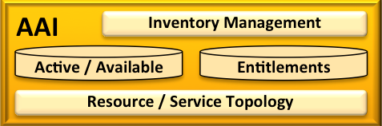
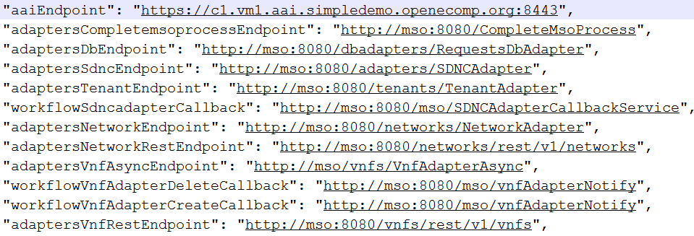

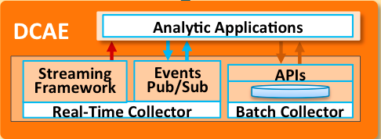
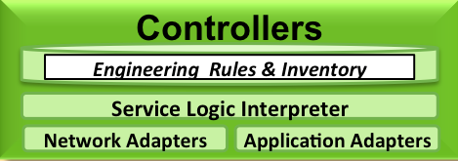
MSB Solution for ONAP: Service Discovery & Routing
Using a configuration file, we might have problems on scaling, failover and update
Before:
VF-C
Service Discovery
MSB
External Service
gateway
Internal API Router
……
After:
"apigateway": "https://apigateway.onap.org:80"
MSB as the single entry point
Other Modules …
How to call service:
GET https://apigateway.onap.org/api/aai/v8/cloud-infrastructure/cloud-regions/cloud-region/{cloud-owner}/{cloud-region-id}
API gateway routes the request to:
MSB handles the service discovery & routing & LB
GET https://c1.vm1.aai.simpledemo.openecomp.org:8443/aai/v8 /cloud-infrastructure/cloud-regions/cloud-region/{cloud-owner}/{cloud-region-id}

Slide 25



MSB Solution: Centralized Auth with Plugin(SSO)
ONAP Services
Centralized Authentication
User send a service request to MSB
MSB auth plugin check the auth token
2.1 If a valid token exist, MSB forward the request to the destination service provider
2.2 If not, MSB forward the request to the Auth Service, and redirect user request to login page
2.3 Auth service create a token cookie after user login with valid name and password
Auth Service
Auth Plugin
Business requests
API Monitoring
User
MSB
Management
requests
Logging
Centralized Authorization(Assuming user already login)
User send a service request to MSB
MSB auth plugin send the user token and request(Http method + Resource url) to Auth Service
2.1 If user has the permission, MSB forward the request to the destination service provider
2.2 If not, MSB return operation not allowed error to user
Other Plugin
Admin
Other Services
Centralized User, Role and Permission Management
Centralized in the Auth Service
Note: Auth Service is not in the scope of MSB
Notes:
Services typically need to call one another. In a monolithic application, the components invoke one another through language-level method or procedure calls.
In a traditional distributed system deployment, services run at fixed, well known locations (IP address and port)，your code can read the network locations from a configuration file that is occasionally updated.
However, a modern microservice-based application typically runs in a virtualized or containerized environments, Service instances have been dynamically assigned network locations. Moreover, the set of service instances changes dynamically because of autoscaling, failures, and upgrades. So, it’s impossible anymore to use a configuration file to get the locations of your services.

Slide 26
Outline
Requirements from ONAP Use cases
Merger Architecture Proposal Overview
Merger Architecture Highlights
ONAP Modeling
ONAP Common Service
ONAP Service Orchestrator
ONAP Controllers
Overview
VF-C
SDN-Agent
Template Driven Closed Loop
Support for Design, Schedule and Execute Changes (e.g. Software Upgrades)
VNF SDK
Resource and Placement Optimization
Operations Management Framework (OMF)
Support for Multiple Infrastructure Environments

Slide 27


Two Layers of Service Orchestration
SO
Global Service Orchestrator
DCI SDN Controller
WAN
Controller
Domain A
Domain B
Domain Service Orchestrator
Domain Service Orchestrator
vFW
DC Controller
DC Controller
vFW
OS
OS
vCPE
vCPE
OS
DC GW
DC GW
OS
TIC-Edge
TIC-Edge
WAN
DC Controller
vLB
vLB
DC Controller
OS
OS
vFW
vFW
OS
OS
vCPE
DC GW
vCPE
OS
DC GW
OS
TIC-Core
TIC-Core
Case 1: lager scale SPs
Case 2: Federated Orchestration
Notes:
In the lager scale SPs, the SPs have a deployment requirement that the E2E Service Orchestrator deployed in the higher location and NFV Orchestrators and VNF Management deployed to the lower location near the managed VNFs to satisfy the high availability and performance.
Some SPs have the cross-country services and need to coordinate other SP’s NFV network resources. They want to use the Service Orchestrator to invoke other SP’s NFV Orchestrator and VNF Management to achieve an E2E network service.

Slide 28
Workflow for Service Orchestration
Declarative (topology) workflow v.s. imperative workflow
Topology driven workflow couples topology modeling with workflow
Issue 1: Not suitable for workflows that cannot be deduced from service topology template
E.g. for interactions with entities outside service template (A&AI, Catalogue, etc.)
Issue 2: Not flexible enough for dynamic workflow, e.g. runtime status dependent
E.g. for location based deployment of VFs among multiple DCs
E.g. dynamic software upgrade workflow based on runtime HA active-backup status
Imperative workflow decouples topology modeling from workflow
Addresses the above two issues
Allows the core workflow specification & execution implementation be topology template agnostic
Avoids complex workflow translation when switching between TOSCA/YANG/HEAT template DM
TOSCA provides both built-in topology and imperative workflow in a single template
Work in progress for TOSCA built-in imperative workflows, addresses Issue 2 but cannot solve Issue 1.
Joint Proposal to extend TOSCA specification to allow for external BPMN/BPEL workflow to address the above issues and be compliant with existing implementations.

Slide 29
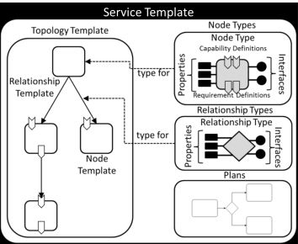
Alternatives for TOSCA Service Orchestration Workflow
Request
Global Service Orchestrator
Request
Service Orchestrator
Determine top-level workflow
BPMN
Determine top-level workflow
Service Agnostic WFs (one for each LCM op)
BPMN
Request
Domain Service Orchestrator
Rainy Day Option:
Invoke Inverse
Determine top-level workflow
Success/Fail
BPMN
Load
Invoke
Service Agnostic WFs
(one for each LCM op)
TOSCA
Orchestrator
Success/Fail
Invoke
Invoke Operation Implementation
Service Specific WFs
Option 1: Topology & BPMN Hybrid Workflow
Option 2: Decoupled 2 layer BPMN Workflow

Slide 30
ONAP TOSCA-based Orchestration Work Proposal – Option 1
Description:
Propose expansion of ONAP to include a declarative topologically-driven approach to orchestration, in addition to imperative BPMN/BPEL capabilities
Enhance ONAP SDC design framework to support integrated or independent use of declarative (TOSCA) and imperative (BPMN/BPEL) models
Enhance ONAP run-time orchestration to process TOSCA models and workflows
While TOSCA is native for cloud resources, BPMN/BPEL imperative orchestration is currently more suitable for supporting complex lifecycle management scenarios
Benefits
Provide a rich design environment supporting declarative and imperative orchestration options
Single template for orchestrating service/resource instantiation and lifecycle management
TOSCA is designed for cloud resources and therefore can natively support applications to be instantiated on cloud infrastructure platforms
Use Cases for Applying TOSCA-based Orchestration in ONAP:
VNF and Service instantiation using TOSCA templates on cloud platforms
TOSCA template created by ONAP SDC design platform and deployed to other components for orchestration
Common template supporting various cloud based technologies such as VM (e.g., Openstack), Containers (e.g., Docker), Container cluster management (e.g., Kubernetes)
TOSCA-based template model integrates multiple lifecycle management actions and workflows
Instantiation
Closed loop actions (restart, stop, self-heal, scale out/scale in, etc.)
Change management (software upgrades, reconfiguration of VNFs)
Service instantiation in a tiered approach employing both TOSCA and BPMN/BPEL
Note: TOSCA-based orchestration is also being introduced in the ECOMP Controller proposal for ONAP component software management

Slide 31

TOSCA-based Orchestration: Option 1
Design Time
Execution Time
Upon receipt of a SO request, initiate appropriate top-level BPMN workflow.
Preference to keep as simple as possible, to promote Declarative processing approach
Request
SDC
Service Orchestrator
Tools for Declarative & Imperative Model Design
Determine top-level workflow
BPMN
Design
Catalog
Runtime
Catalog
Service Model
Model Distribution
Service Model
Metadata Model Driven Orchestration
Service Model
Service Model
Service Model
Service Model
Success/Fail
Rainy Day Option:
Invoke Inverse
Resource Model
Load
Invoke
Resource Model
Resource Model
Resource Model
Resource Model
Resource Model
Invoke Operation Implementation
TOSCA
Orchestrator
For each BPMN work step that delegates to the TOSCA Orchestrator:
Determine the associated TOSCA Service Template and associated Inputs
load into the TOSCA Orchestrator
Call TOSCA Orchestrator to perform the relevant action
The TOSCA Orchestrator uses the Service Template to determine the proper Operations and sequencing thereof on the various Node Types
AT&T Proprietary (Restricted)

Slide 32
ONAP TOSCA-based Orchestration Proposal – Option 2
Implementation Proposal
Standard TOSCA parser decoupled from workflow execution
BPMN/BPEL workflow engine for two layer workflows
High level architecture principles
Be Decoupled and micro-serviced based
Be practical or available on time
Leverage what is available and mature and do not reinvent the wheel
Notes:
OPEN-O architecture principles
Be Decoupled and micro-serviced based” is very important, the Selection should not cause us to bind with one special platform/product and no other choice, or bind to a large platform that must be integrated before provide the required service.
Be practical or available on time, yes, it’s principle for all open source community. All selections should be able catch up with our deliver plan, don’t lets all others wait for that selection to be mature.
Do not reinvent the wheel, so that it ‘s encourage to reuse or interwork with exist product or solution.

Slide 33
ONAP TOSCA-based Orchestration Proposal: Option 2
Design Time
Execution Time
Upon receipt of a SO request, initiate appropriate top-level BPMN workflow.
Request
SDC
Domain Service Orchestrator
Tools for Imperative Model Design
Determine top-level workflow
BPMN
Design
Catalog
Runtime
Catalog
Service Model
Model Distribution
Service Model
Metadata Model Driven Orchestration
Service Agnostic WFs
Service Model
Service Model
Service Model
Service Model
Success/Fail
Resource Model
Invoke
Resource Model
Resource Model
Resource Model
Resource Model
Resource Model
Service Specific WFs
For each service agnostic work step that delegates to the next level of workflow:
Determine the associated service workflow and associated Inputs
perform the relevant action
The same BPMN workflow engine executes the two layer service workflows.
AT&T Proprietary (Restricted)

Slide 34
Outline
Requirements from ONAP Use cases
Merger Architecture Proposal Overview
Merger Architecture Highlights
ONAP Modeling
ONAP Common Service
ONAP Service Orchestrator
ONAP Controllers
Overview
VF-C
SDN-Agent
Template Driven Closed Loop
Support for Design, Schedule and Execute Changes (e.g. Software Upgrades)
VNF SDK
Resource and Placement Optimization
Operations Management Framework (OMF)
Support for Multiple Infrastructure Environments

Slide 35
ONAP Controller Framework
Summary:
ONAP Controller Family include SDN-C, APP-C, SDN Agent & VF-C
SND Agent for interfacing with third party controller and VF-C for interface with Vendor VNFM /EMC
Service Orchestrator will call the right controller, depending on the VNF being managed
Goal is create as much commonality between controller as possible, to the rest of ONAP all controllers look and behave the same way
Service Orchestrator
SDN-C
APP-C
Compiler
API Handlers
Compiler
API Handlers
Configuration Repository
MD-SAL Context DB
Compiler
API Handlers
Operational & Config Tree
(Svc Model)
Policy Cache &
Event Matching
Service Logic Execution
Service Logic Interpreter
SDN-C Database
Policy Cache &
Event Matching
Service Logic/Eng Rules
Policy Cache & Event Matching
Service Topology & VF State
Service Logic Execution
Assigned Inventory
SDN Agent
Config
Tree
Operational Tree
Service Logic Interpreter
VF-C
Adaptors
Adaptors
…
Adaptors
Adaptors
Adaptors
Adaptors
Adaptors
Adaptors
…
Adaptors
Adaptors
Adaptors
Adaptors
3rd Party Controller
VNFM / EMS
3rd Party Controller
VNFM / EMS
3rd Party Controller
VNFM / EMS

Slide 36
Outline
Requirements from ONAP Use cases
Merger Architecture Proposal Overview
Merger Architecture Highlights
ONAP Modeling
ONAP Common Service
ONAP Service Orchestrator
ONAP Controllers
Overview
VF-C
SDN-Agent
Template Driven Closed Loop
Support for Design, Schedule and Execute Changes (e.g. Software Upgrades)
VNF SDK
Resource and Placement Optimization
Operations Management Framework (OMF)
Support for Multiple Infrastructure Environments

Slide 37
VF-C Introduction
Using ETSI NFV MANO architecture and information model as a reference, and targeted at implementing the NFV-O/GVNFM Component that provides orchestration for Network Services composed of Virtualized Network Functions and general VNF management.
NFV domain network service automation delivery via VF-C is at the heart of realizing service agility, which significantly reduces time to market for new service offerings and reduces CAPEX/OPEX.
Multi VNF Manager, EMS and VIM integration via drivers enables ONAP to manage more different vendor VNFs
Multi NS/VNF templates via different parsers enable more SDO data models(TOSCA/Yang/Heat, etc) to be instantiated.
Notes:
Service Agility has been the major promise of SDN/NFV to service providers in transforming their legacy infrastructure into the virtualization paradigm.
Automation of service delivery via NFV orchestration is at the heart of realizing service agility, which significantly reduces time to market for new service offerings and reduces CAPEX/OPEX.
This project is targeted at implementing the NFV-O Component that provides orchestration for Network Services composed of Virtualized Network Functions, as an integral part of ONAP.
This project is also targeted at implementing plugins/drivers to enable support for multiple VIM, VNFM or EMS from different vendors.

Slide 38
How VF-C Fit into ONAP Architecture
ONAP
Common Services
A&AI
Portal
SO
Policy
Inventory
Adaptor
Adaptor
Adaptor
Inventory Data CRUD
NS&VNF LCM
SDC
Distribution Service
NS/VNF Package
Virtual Function Controller (VF-C)
DCAE
Adaptor
Adaptor
Create/Delete/… Virtual Resources
Create/Delete/… ViNF
Config/…
ViNF
Create/delete/…
SFC
FM/PM…
VIM
VNFM
EMS
3rd SFC Controllers
3rd VIMs
3rd SFC Controllers
3rd VNFMs
3rd EMSs
Portal/SDC/MSO/Policy add adaptor for VF-C RESTAPI
VF-C add adaptor for A&AI\Common services,etc
DCAE collects data from EMS via new adaptor
Cloud
VNF
vCE
VNF
VNF
Extension
VNF

Slide 39
VF-C Solution : VFC Components& Main Features
API Handler
Support BPMN/BPEL workflow
Support NFV information Model and multi data models
Support ETSI architecture and IFA interfaces
Support VNF EPA features
Integrated with 3rd VNFMs and VNF, such as Ericsson, JUJU, Huawei, and ZTE, etc
Integrated with multiple cloud systems, such as redhat, vmware, windriver, and unbantu, etc
NFV Lifecycle Management
NFV
Information Model
Workflow Engine
Wo
W
Workflow Templates
Drivers
3rd EMS Driver
3rd EMS Driver
3rd EMS Driver
3rd VNFM Drivers
3rd EMS Driver
3rd EMS Driver
3rd EMS Driver
3rd EMS Drivers
VIM Drivers
3rd SFC Drivers

Slide 40
Outline
Requirements from ONAP Use cases
Merger Architecture Proposal Overview
Merger Architecture Highlights
ONAP Modeling
ONAP Common Service
ONAP Service Orchestrator
ONAP Controllers
Overview
VF-C
SDN-Agent
Template Driven Closed Loop
Support for Design, Schedule and Execute Changes (e.g. Software Upgrades)
VNF SDK
Resource and Placement Optimization
Operations Management Framework (OMF)
Support for Multiple Infrastructure Environments

Slide 41
Outline
Requirements from ONAP Use cases
Merger Architecture Proposal Overview
Merger Architecture Highlights
ONAP Modeling
ONAP Common Service
ONAP Service Orchestrator
ONAP Controllers
Template Driven Closed Loop
Support for Design, Schedule and Execute Changes (e.g. Software Upgrades)
VNF SDK
Resource and Placement Optimization
Operations Management Framework (OMF)
Support for Multiple Infrastructure Environments

Slide 42
Closed-Loop Repeating Design Pattern
Service
Elements
Storage
Compute
Applications
Service
Orchestration
Controller
Policy
Loop
NFV Elements
DCAE
Compute
Network Functions
Orchestration
Controller
Storage
Network
Policy
Loop
Cloud Elements
DCAE
Compute
Applications
Cloud
Orchestration
Controller
Policy
Loop
DCAE

Slide 43
Control Loop Design and Execution Flow
Control Loop Design Time
SDC
Create template,
Configure CL,
Deploy CL,
Stop/Restart,
Reconfigure
Onboard VNF,
Alarm file and
create service
Test, Certify,
Distribute
Closed Loop
Query services, VNFs
Get performance counter file
Submit closed loop for distribution
Control Loop
Management Cockpit
Distribute Control loop
Deploy
control loop
Check
distribution status
Create and
Activate policies: TCA
and
Operational,
Stop/Start,
Reconfigure
Service Change Handler
DCAE Dispatcher
DCAE Inventory
Cloudify
(includes plugins)
Databus Controller
CDAP Broker
Policy
Engine
VES Collector
TCA
DCAE
Docker
CDAP
Control Loop Runtime Execution Example
DMaaP
VF
VES
TCA
Signature Detected
DROOLS
Policy
Initiate
Action
Action
Execution
Docker
CDAP
Source
DCAE Collector
DCAE Analytic
Policy Engine
App-C
NETCONF

Slide 44
Outline
Requirements from ONAP Use cases
Merger Architecture Proposal Overview
Merger Architecture Highlights
ONAP Modeling
ONAP Common Service
ONAP Service Orchestrator
ONAP Controllers
Template Driven Closed Loop
Support for Design, Schedule and Execute Changes (e.g. Software Upgrades)
VNF SDK
Resource and Placement Optimization
Operations Management Framework (OMF)
Support for Multiple Infrastructure Environments

Slide 45
VNF Change Management Process
Design:
Building blocks for individual tasks
Design workflow as a composition of building blocks
Scheduling:
Schedule optimization for avoiding conflicts
Conflict rules as policies
Execution:
Automated workflow orchestration and tracking
Ability to intercept execution – pause/resume
Policy enabled go/no-go
Improved manageability: Systematic design of workflow, scheduling and execution
Minimize service disruption: conflict avoidance for schedule and automated roll-out/fall-backs

Slide 46
CM Process Design
SDC (catalog)
CM Building Blocks in Catalog
DCAE micro-services, A&AI APIs, Controller capabilities (e.g., health check APIs), scripts/workflows.
Onboard component
capabilities
DCAE
A&AI
Controllers
(APP-C, SDN-C)
CM Designer
Modular composition to stitch different building blocks into a workflow (using a visual designer) e.g., In-place software upgrade, Build and Replace.
SDC (CM Designer)
SDC (CM catalog)

Slide 47
Change Management Scheduling & Conflict Avoidance
ONAP Portal
CM Portal
CM Schedule Optimizer -> SNIRO
Create a schedule/plan for rolling out a change such that we minimize service disruption during the change within the specific completion time
Dependency modeling
Conflict scoping
Service Impact scoping
Execution ordering
5
1
7
6
CM schedule optimizer (SNIRO)
4
CM Orchestration
3
3
3
2
Tracking/ Notification OSS
DCAE
A&AI
Policy
1 – Send workflow, VNF list and time range to SNIRO
2 – Request constraints for scheduling
3 – Request data for schedule optimization
4 – Identify CM schedule
5 – Provide the schedule for approval
6 – Once approved, send the schedule to Change tracking/notification OSS.
7 – Push the approved change schedule for execution

Slide 48
Change Execution
ONAP Portal
CM Portal
Orchestration Execution:
Execute the orchestration building blocks and use RESTAPIs to interface controller for software upgrade, or A&AI for updates to the CM flag
ONAP Portal:
Track status of CM workflow execution – success/failure status of each building block
Intercept CM workflow execution – pause/resume functions, and ability to inject new steps in the workflow
Pre / Post Analytics:
Performance analytics – pre/post performance comparisons, go/no-go decisions for network-wide deployment
**
2b
1
Orchestration
Policy
2
5
6
7
4
8
3
7b
DCAE
A&AI
Controllers
(APP-C, SDN-C, SDN-O, MCAP)
1 – Start execution based on schedule
2 – Conflict check
2b – Check roll-out status
3 – (Pre) health check
4 – Update CM flag
5 – VNF upgrade
6 – (Post) health check
7 – Pre/post impact analysis
7b – Fallback (possibly)
8 – Update CM flag
** – Status tracking and pause/resume execution at any/all times

Slide 49
Outline
Requirements from ONAP Use cases
Merger Architecture Proposal Overview
Merger Architecture Highlights
ONAP Modeling
ONAP Common Service
ONAP Service Orchestrator
ONAP Controllers
Template Driven Closed Loop
Support for Design, Schedule and Execute Changes (e.g. Software Upgrades)
VNF SDK
Resource and Placement Optimization
Operations Management Framework (OMF)
Support for Multiple Infrastructure Environments

Slide 50
VNF Onboarding SDK
Description:
Propose to build an SDK and automation/devOps tools for VNF onboarding.
This functionality uses VNF guidelines & information model as needed.
This project implements methods and processes for VNF vendors to onboard ONAP compliant VNF packages to Service Providers or market place, including automated ingestion to Design Platform (SDC).
This project focuses on the SDK tools, not ONAP business models (e.g., market place).
Benefits:
Provide a standard packaging and submission process for VNF vendors to multiple ONAP service providers.
Enforce VNF packages to meet ONAP standards and requirements for deployment and lifecycle management of the VNF products.
Reduce the costs of onboarding and to provide speedy time-to-market of the VNFs.
Use Cases:
Vendor uses SDK to validate VNF package.
Service Provider uses SDK to automate ingestion of a VNF package to SDC Design Platform.

Slide 51
VNF Onboarding SDK
SP’s SDC
SP additional Validation & Onboarding
Supplier A
VNF
Package
ONAP Compliant
1. Service Provider Option
SDK
Create & Validate
Certified VNF
Package
SDK Validate & Onboard
Supplier B
VNF
Package
ONAP Compliant
SDK
Create & Validate
SP’s SDC
Supplier A
VNF
Package
Certified VNF
Package
SP additional Validation & Onboarding
2. Supplier-SP Option
SDK Validate & Onboard
Supplier B
VNF
Package
SDK
Create & Validate
Certified VNF
Package
Market Place
SP’s SDC
VNF Catalog
SP additional Validation & Onboarding
Supplier A
VNF
Package
ONAP Compliant
Certified VNF
Package
SDK Validate & Onboard
3. Marketplace Option
SDK
Create & Validate
Supplier B
VNF
Package
Certified VNF
Package
Optionally to include SP specific configuration changes

Slide 52
Outline
Requirements from ONAP Use cases
Merger Architecture Proposal Overview
Merger Architecture Highlights
ONAP Modeling
ONAP Common Service
ONAP Service Orchestrator
ONAP Controllers
Template Driven Closed Loop
Support for Design, Schedule and Execute Changes (e.g. Software Upgrades)
VNF SDK
Resource and Placement Optimization
Operations Management Framework (OMF)
Support for Multiple Infrastructure Environments

Slide 53
ONAP Optimization Framework (ONAP-OF)
The ONAP Optimization Framework (ONAP-OF) is being proposed as a new platform component that to introduce the Homing, License and Change Management Schedule optimizers in an manner that allows other implementers to also extend or replace the optimizations supported with their specific optimizers.
Background:
Optimization was an early concept in ECOMP (to many objects for manual mechanisms)
Spans Service, Network, Infrastructure, and Resources
ECOMP has four (4) optimizers today:
Placement
Within a cloud instance
Integrated with OpenStack
Homing
Spans cloud instances
Policy driven
Provides ability for business, service, and network rules to be used in selecting locations for service resources
License
Selects Software Entitlements and License Keys for software being deployed or reconfigured
Allows complex criteria, conformant to contractual constrictions to be used
Allows for business rules to drive cost reductions in entitlements used
CM Schedule
Uses Rules to avoid conflicts between related elements during scheduled software change/upgrade activities
Evaluates Vertical Relationships (implementation stack)
Evaluates Horizontal Relationships (service path)

Slide 54
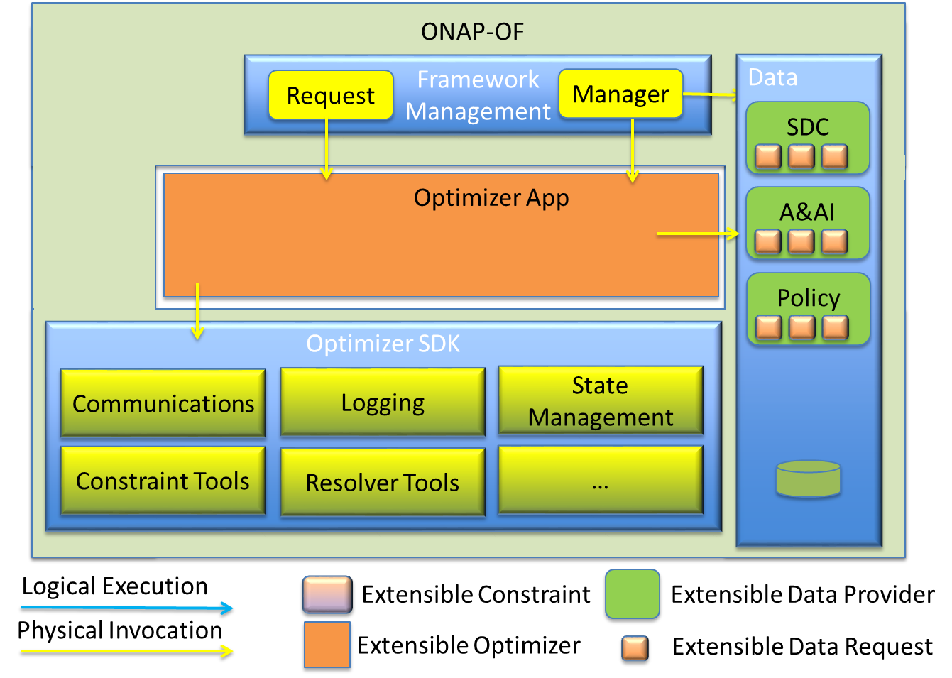
ONAP Optimization Framework (ONAP-OF) Proposal
ONAP-OF SCOPE
ONAP-OF Reference Architecture
Develop an extensible framework to deploy optimization applications for ONAP
Provide standard interface for optimization requests from other ONAP entities.
Interact with ONAP-C for micro service management
Provide Management framework that will allow:
New Optimizers Applications to be deployed in a distributed manner
Provide ability to add Optimization Data Providers
Provide ability to add new data sets that can be provided by a Data Provider
Provide three (3) sample Optimizers
Homing allows selection of cloud instances to be used for service components
License allows complex criteria to be used in selecting software entitlements and license keys needed to enable deployed software
CM Schedule allows policy to dictate conflicts to avoid when attempting to establish a schedule for a large number of SW instances requiring modification.

Slide 55
Outline
Requirements from ONAP Use cases
Merger Architecture Proposal Overview
Merger Architecture Highlights
ONAP Modeling
ONAP Common Service
ONAP Service Orchestrator
ONAP Controllers
Template Driven Closed Loop
Support for Design, Schedule and Execute Changes (e.g. Software Upgrades)
VNF SDK
Resource and Placement Optimization
Operations Management Framework (OMF)
Support for Multiple Infrastructure Environments

Slide 56
ONAP : Operations Management Framework (OMF)
OMF Portal : Provides GUI for operations team to perform tasks such as:
Request for Network Configuration Change
Execute workflow for network change
Administrative tasks such as Role based access to OMF
Execute test case
OMF Middleware :
Business Logic Layer : implement O&M functions as uS and reusable components e.g. New Service Rollout Mgmt
Integration Layer : Build cartridges/adaptors to interface with external systems.
OMF Configuration Engine
Manage, Perform and Orchestrate Service level Configuration changes
OMF Test Engine
Perform Service Regression, Validation tests, Device Health check Tests.

Slide 57
Outline
Requirements from ONAP Use cases
Merger Architecture Proposal Overview
Merger Architecture Highlights
ONAP Modeling
ONAP Common Service
ONAP Service Orchestrator
ONAP Controllers
Template Driven Closed Loop
Support for Design, Schedule and Execute Changes (e.g. Software Upgrades)
VNF SDK
Resource and Placement Optimization
Operations Management Framework (OMF)
Support for Multiple Infrastructure Environments

Slide 58
Multiple Infrastructure Support Abstraction Layer
Enhancement Summary:
Expand ONAP SDC to Capture Artifacts to Support Multiple Infrastructure Environment
Create an Infrastructure Abstraction Layer with Adaptors for Various Infrastructures
Service Orchestrator and other ONAP Applications will Interface with the Abstraction Layer with right template
Infrastructure Abstraction Layer will Interact with Different Infrastructures and pass right templates
This is a very high level view, additional design details to be worked with the TSC controller sub-group.
Under Development
Design Environment
Execution Environment

Slide 59
Multiple Infrastructure Support
Create an Infrastructure Abstraction Layer with Adaptors for Various Infrastructures
Service Orchestrator and other ONAP Applications will Interface with the Abstraction Layer for infrastructure functions
Infrastructure Abstraction Layer will Interact with Different Infrastructures and pass right templates
SDC
A&AI
Service Orchestrator
DCAE
Catalog
VF-C
APP-C
API Handler
collector
Registry Manager
Logic Engine to
validate/dispatch/verify
template
Infrastructure -C
physical Adaptor
Multi-vim Adaptor
Physical Host
Expand ONAP SDC to Capture Artifacts to Support Multiple Infrastructure Environment
Expand A&AI to contain registries of VIM information
capabilities
version
meta data
Container
Infrastructure-C to provide one unified entry to multiple infrastructure environments:
Called by both APP-C and VF-C
Authentication Federation
Standard API on infrastructure LCM, health check/recover
expose monitoring/alerts/events for DCAE or any consumer
VMware
OpenStack
Design time
Run time

Slide 60
Close Look at Infrastructure-C
API Handler
Accept REST request and encapsulate returns
Taking care of parallelism
Registry Manager:
Support registry/un-registry of NFVI
Publish/Update infrastructure capability/version/meta to A&AI service
Logic Engine
Call Registry Manager and execution validation logic
Dispatch API calls to different Adaptors/Plugins
Verify results from Adaptors/Plugins
Multi-vim Adaptor:
Handle different VNFI including OpenStack(different versions), VMware and so on.
Expose monitoring metrics/alerts/events for the consumption of DCAE
Physical Adaptor:
Handle physical host related functions, like fencing for HA recover -- a key step for service resilience
API Handler
Logic Engine to
validate/dispatch/verify
Registry Manager
Logic Engine to
validate/dispatch/verify
Infrastructure -C
physical Adaptor
Multi-vim Adaptor
Physical Host
Container
VMware
OpenStack

Slide 61
BAKCUP SLIDES

Slide 62



Proposed ONAP Merged Architecture
E – Services BSS / OSS Big Data
ONAP Portal
Dashboard
External Data Movement & APIs
OA&M Operation Administration & Maintenance
Active & Available Inventory
Service Orchestrator
Service Design & Creation
Policy Creation
Common Services, Data Movement, Access Control & APIs
Data Collection & Analytics
Controllers
Analytic Application Design
SDN
Agent
Infra.
Cont
network
Cont
App.
Cont
VF
Cont
Operational Functions
Recipe/Engineering Rules & Policy Distribution
3rd Party Controller
VNFM / EMS
ONAP Controller
Design Functions
Storage
Compute
Networking
VNFs / Applications
© 2017 AT&T Intellectual Property. All rights reserved. AT&T, Globe logo, Mobilizing Your World and DIRECTV are registered trademarks and service marks of AT&T Intellectual Property and/or AT&T affiliated companies. All other marks are the property of their respective owners.

Slide 63
Proposed ONAP Merged Architecture
Service Orchestrator (SO)
Orchestrates and manages the delivery, modification or removal of networks & services
Provides cross domain orchestration and coordination
Integrate TOSCA end-to-end orchestration
E – Services BSS / OSS Big Data
Active & Available Inventory (A&AI)
Real-time topology map with context views of virtual networks, services and applications
Uses the network resources as the database of record due to their dynamic nature
ONAP Portal
Dashboard
External Data Movement & APIs
OA&M Operation Administration & Maintenance
Active & Available Inventory
Service Orchestrator
Service Design & Creation
Policy Creation
Common Services, Data Movement, Access Control & APIs
VNF SDK
Data Collection & Analytics
Controllers
Analytic Application Design
SDN
Agent
Infra.
Cont
network
Cont
App.
Cont
VF
Cont
Design Platform
Service Design: environment to define service and resource, constraints, instantiation & modification recipes.
Policy Creation: Associate anomalous and actionable conditions with automated remedy actions
Provides SDK to onboard and certify Vendor VNFs
Controllers
Network: Configuration Management of VNFs, infrastructure networking & WANs
Service/App: configures & manages of Service VFs
VF-C: works with DCAE, policy and orchestrator to provide Life cycle and FCAPS management for complicated VNFs, and provides adaptors to support vendor EMS / VNF-Manager
SDN Agent: adaptor for 3rp party controllers.
Infrastructure: Configuration Management of infrastructure (compute, storage, etc.)
Operational Functions
Data Collection, Analytics & Events (DCAE)
Collects Telemetry Data from VNFs and other sources
Analytic Applications Detect Anomalous conditions
Publishes Actionable conditions
Recipe/Engineering Rules & Policy Distribution
3rd Party Controller
VNFM / EMS
ONAP Controller
Design Functions
Storage
Compute
Networking
VNFs / Applications
© 2017 AT&T Intellectual Property. All rights reserved. AT&T, Globe logo, Mobilizing Your World and DIRECTV are registered trademarks and service marks of AT&T Intellectual Property and/or AT&T affiliated companies. All other marks are the property of their respective owners.

